Slide 1
Lab Test of CO₂ injection in Fractured Ekofisk Chalk

Slide 2
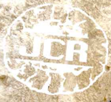
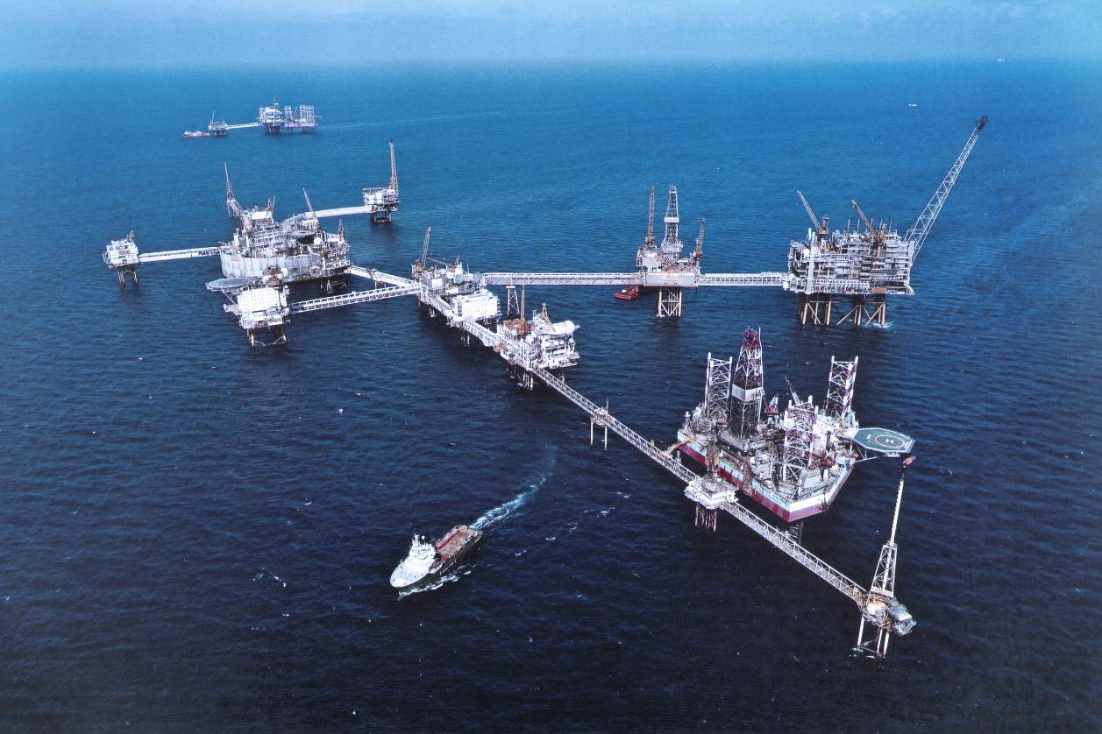
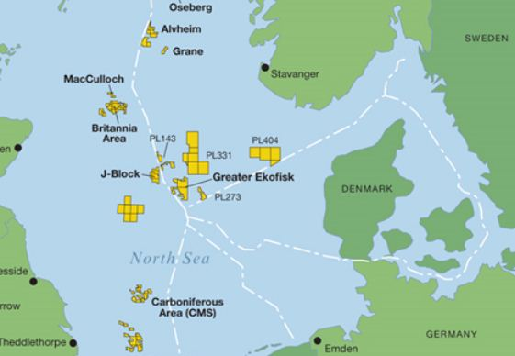
Research Overview
JCR 7 (JOINT CHALK RESEARCH)
Transport Mechanisms of CO2 in Fractured Chalk
Project Duration: 2013-2017
JCR consortium: Norwegian Petroleum Directorate (NPD), Danish Energy Agency, the Danish North Sea Fund, BP, ConocoPhillips, DONG, ENI, Hess, Maersk Oil, Shell, Statoil, and Total.
Research Description
Develop and test a proper description of diffusion and transport effects in fractured chalk systems with CO2, water and oil.
EKOFISK- FRACTURED RESERVOIR
Page 2

Slide 3
Slide 3
Aim was:
Experiment
(Expensive~1-2m NOK)
Mechanistic Modeling
Determine Important Parameters for oil field

Slide 4
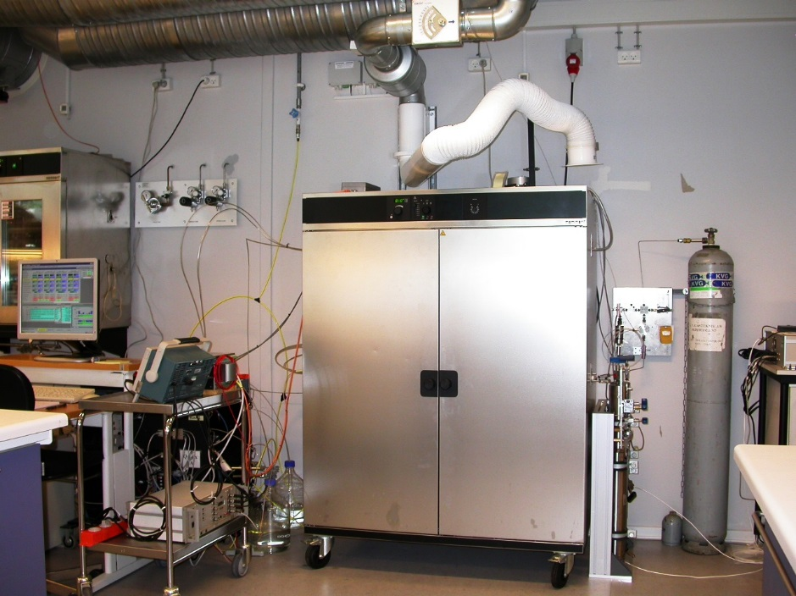
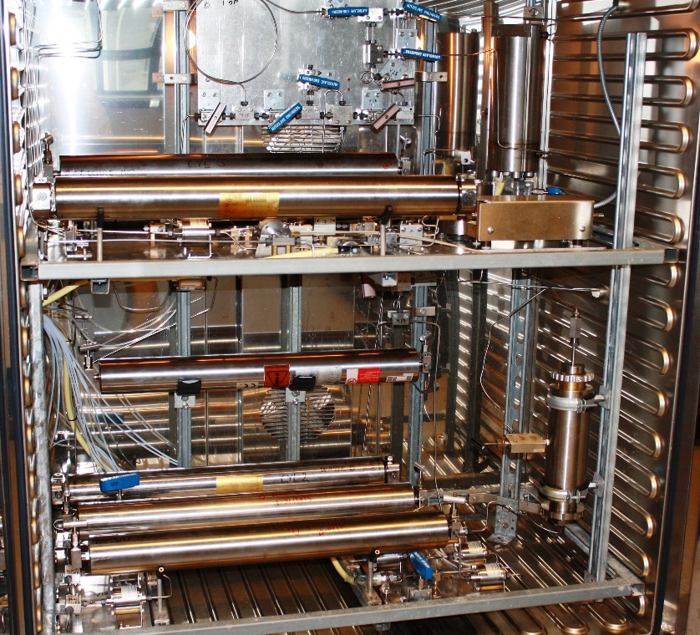
Experiment Runs at High Pressure & High Temperature

Slide 5
Flooding Experiment
Water Flooding Period
CO2 Flooding Experiment

Slide 6
Core Properties
WF+ CF
Test Procedure
CO2
Oil + water
Oil + CO2+Water
water

Slide 7
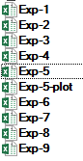
Experiment Properties
features were added to make sure internal validity

Slide 8
For a given Exp. We measure:
Pressure (time)
Produced Oil Rate during WF (time)
Produce oil rate during CF (time)
Produce water WF & CF (time)
Water injection (time)
CO₂ injection (time)
Pressure (time) : usually constant

Slide 9
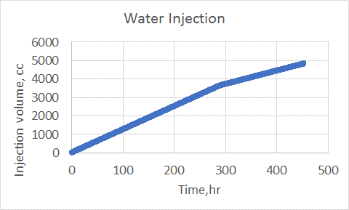
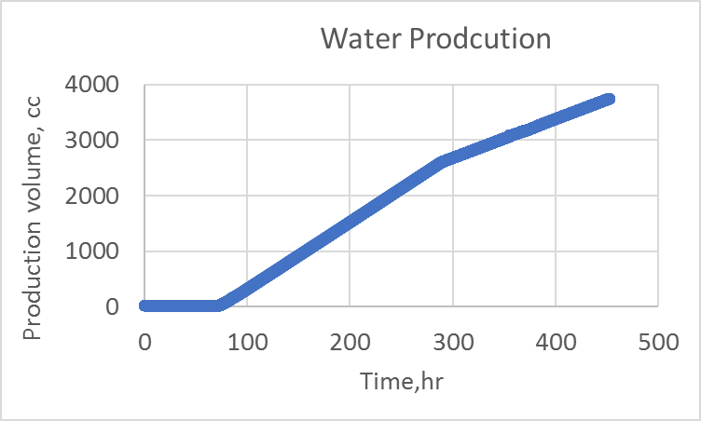
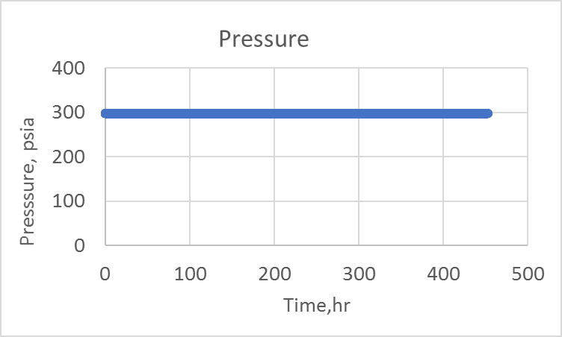
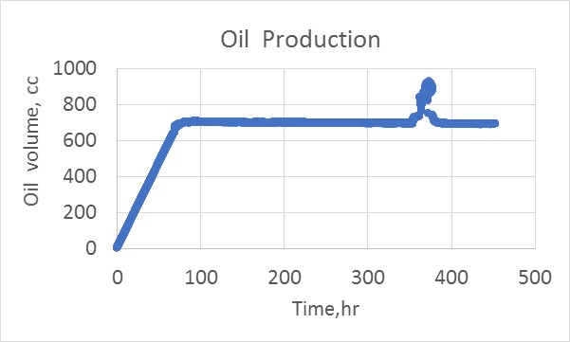
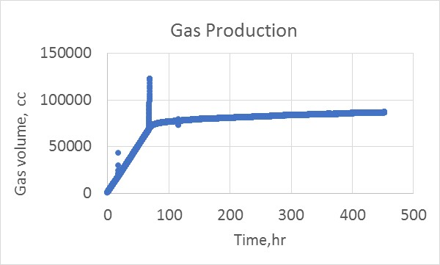
WF

Slide 10
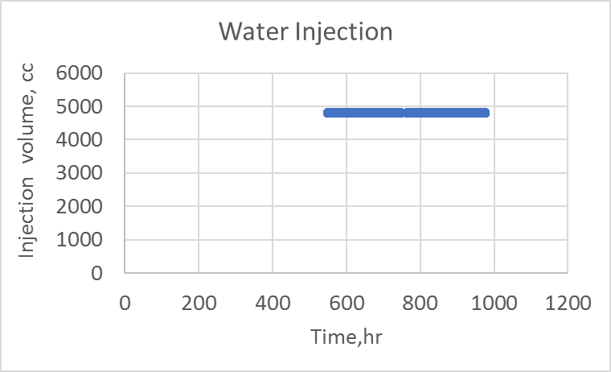
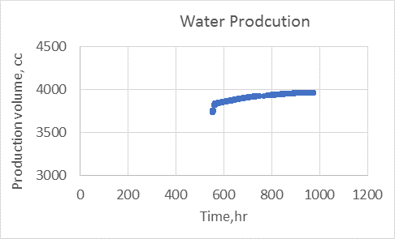
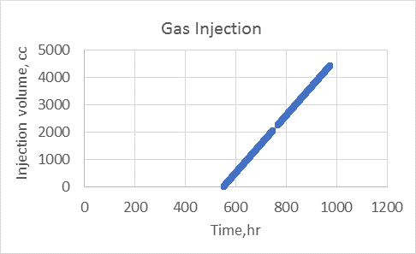
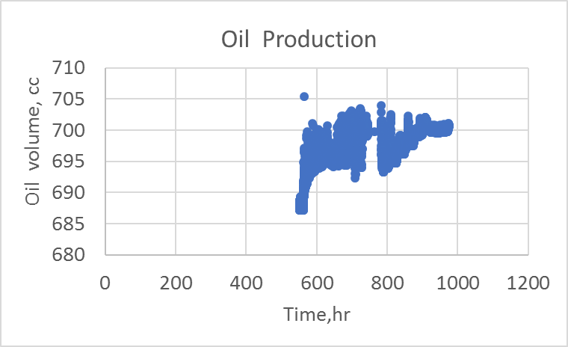
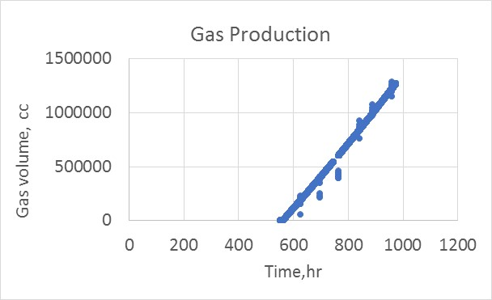
CF

Slide 11
How to estimate time series for a given Exp. Properties?
Exp?

